Slide 1

Simplify Development of your Fiori Apps with SAP Fiori elements and SAP Fiori tools
Mariana Naboka, Marcel Wächter
May 15th, 2020

Slide 2
SAP Labs Preview

Slide 3
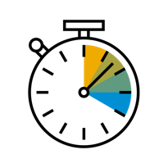


SAP Fiori elements boosts developer productivity
Development Efficiency
UX Consistency
Enterprise Readiness
Standardized page types allow developers to:
Focus on business logic and back-end services
Leverage proven UI concepts
SAP-delivered specifications for data and controls ensure:
A centrally managed user experience
Out-of-the box forward compatibility
Organizations can rapidly and consistently:
Deliver high quality applications to end-users
Benefit from best practices to scale app creation

Slide 4
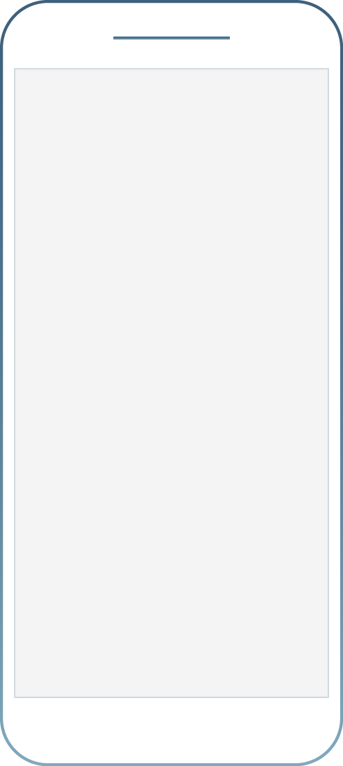
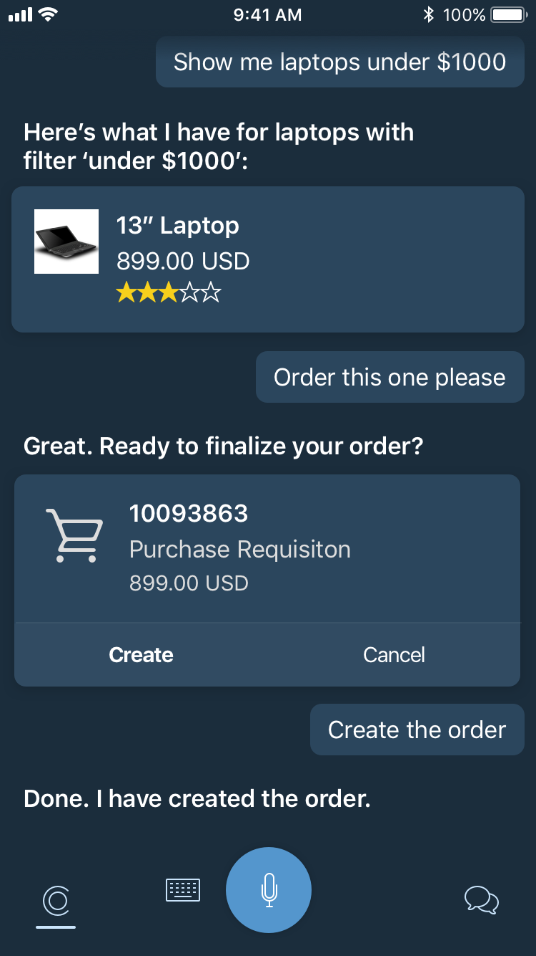
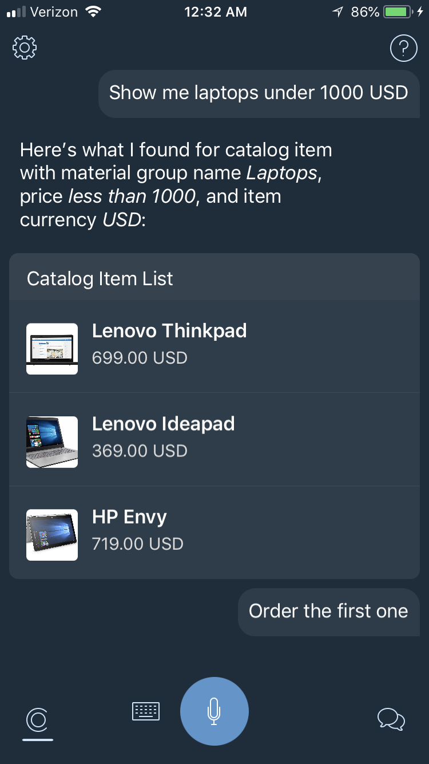
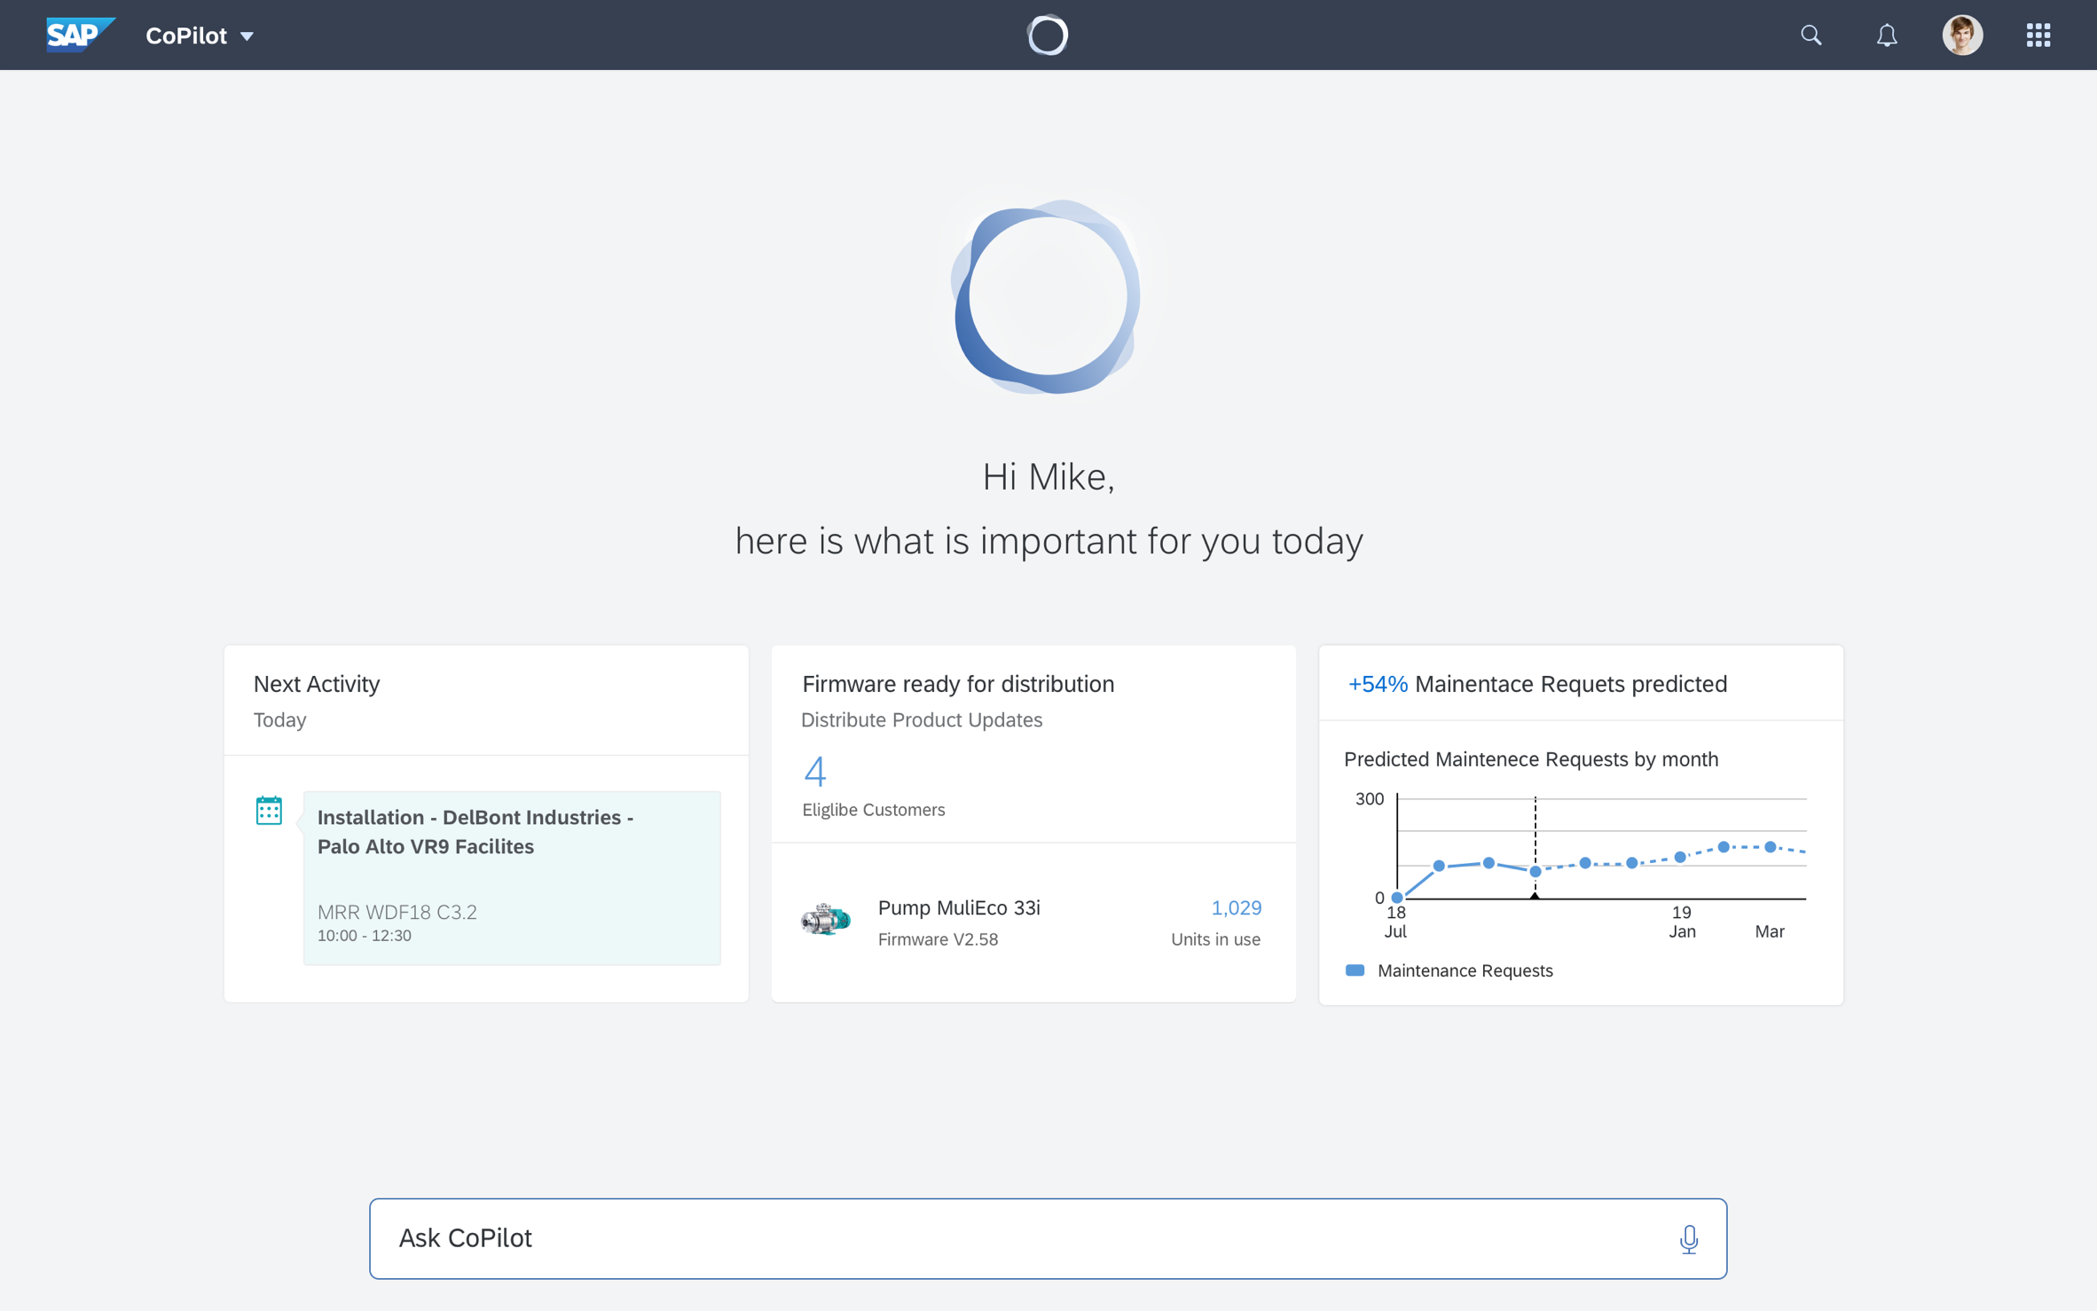
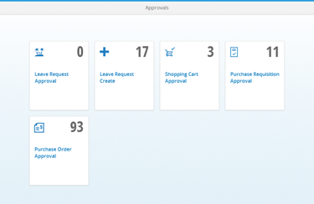
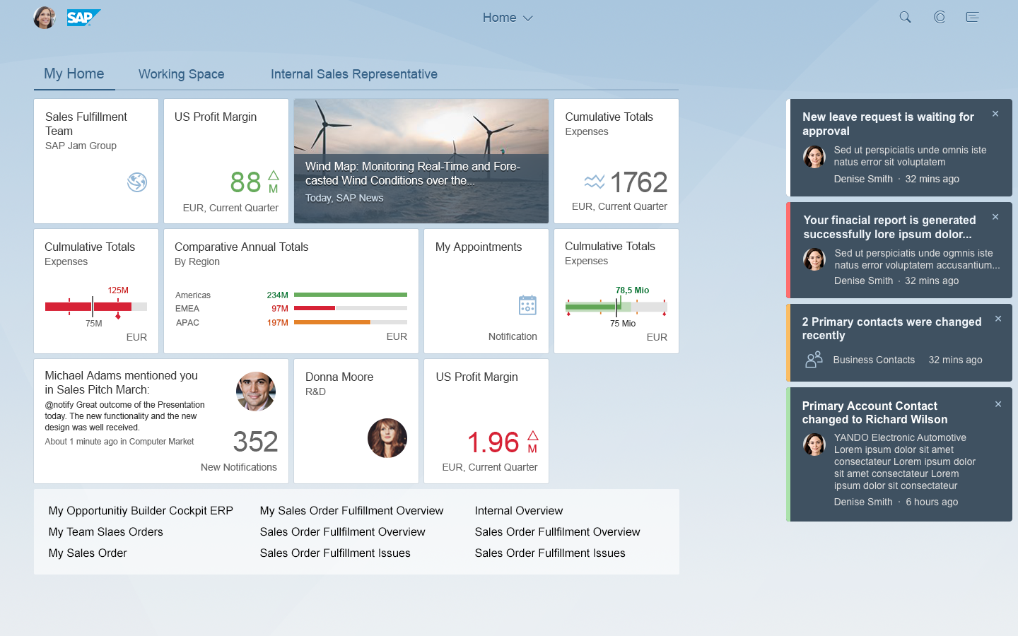
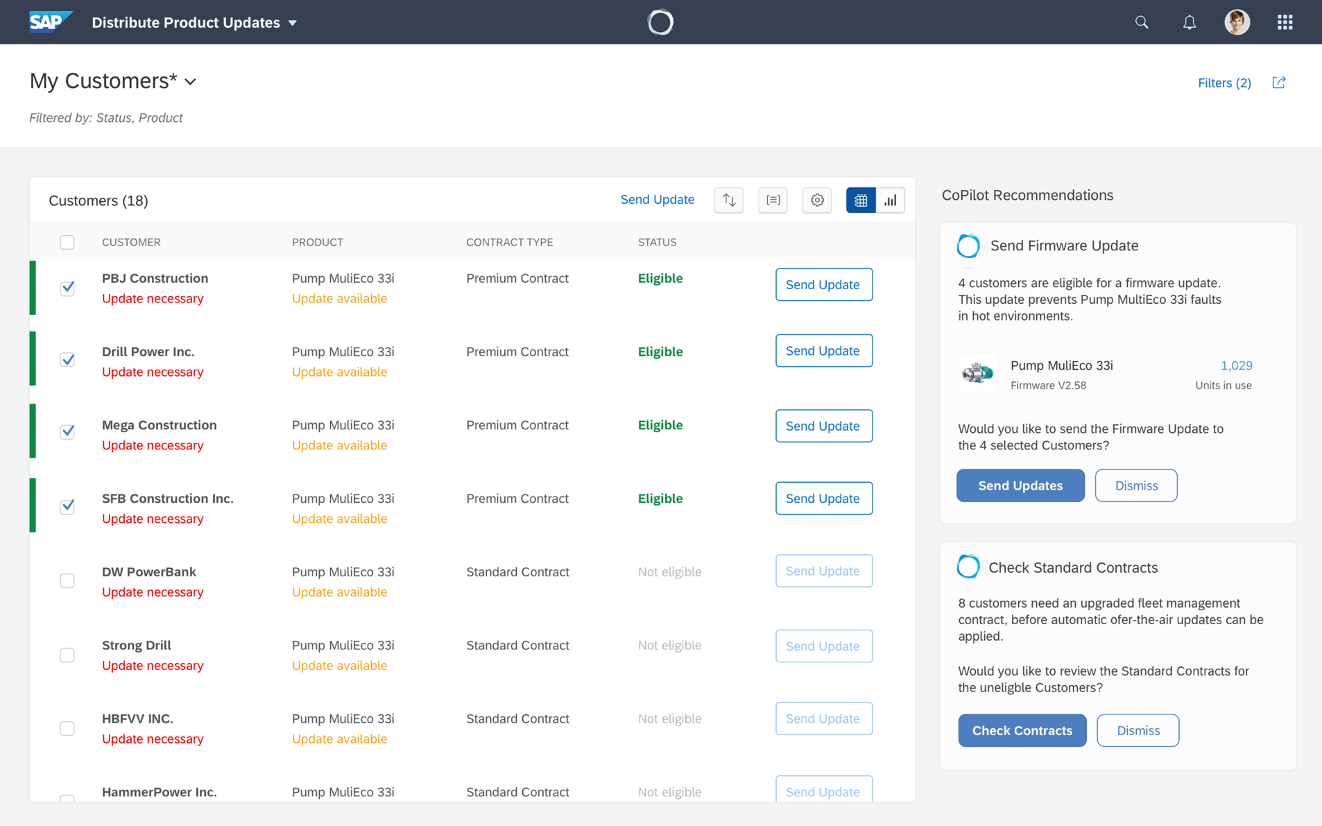
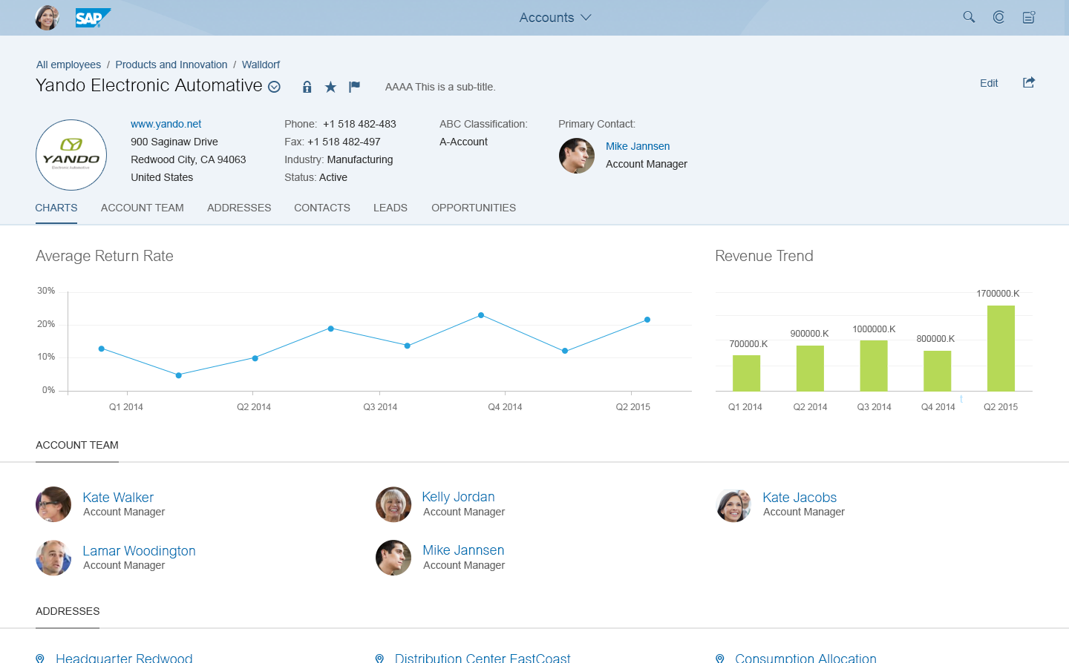
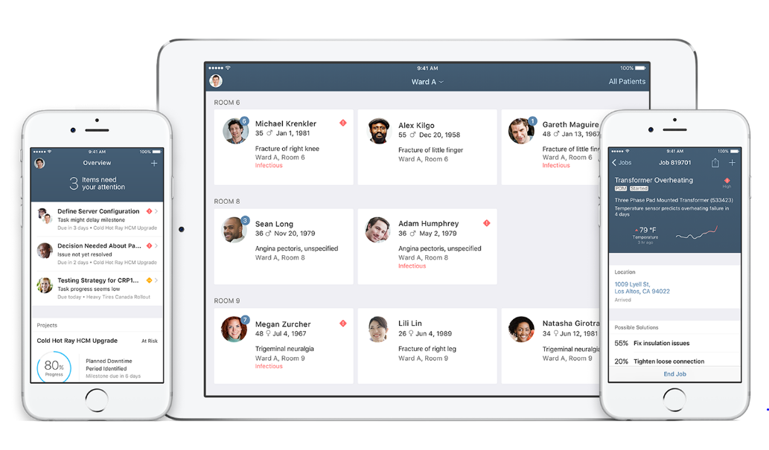
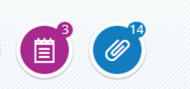
SAP Fiori guidelines are evolving
SAP Labs preview
SAP Fiori 3
2019
SAP Fiori 2.0
2016
SAP Fiori
2013
SAP Fiori Design guidelines: https://experience.sap.com/fiori-design/

Slide 5
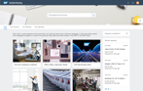
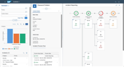
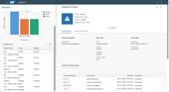
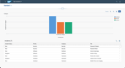
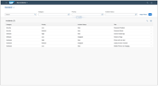
SAP Fiori elements provides rapid, scalable development
Freestyle development
Extension development
Time to develop
SAP Fiori elements
Application complexity

Slide 6
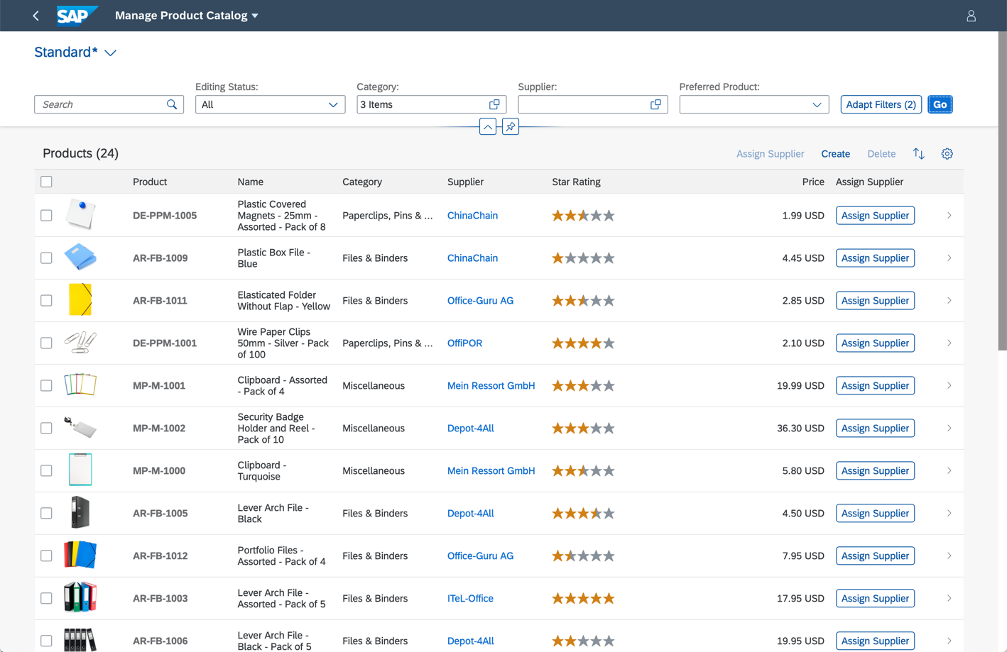
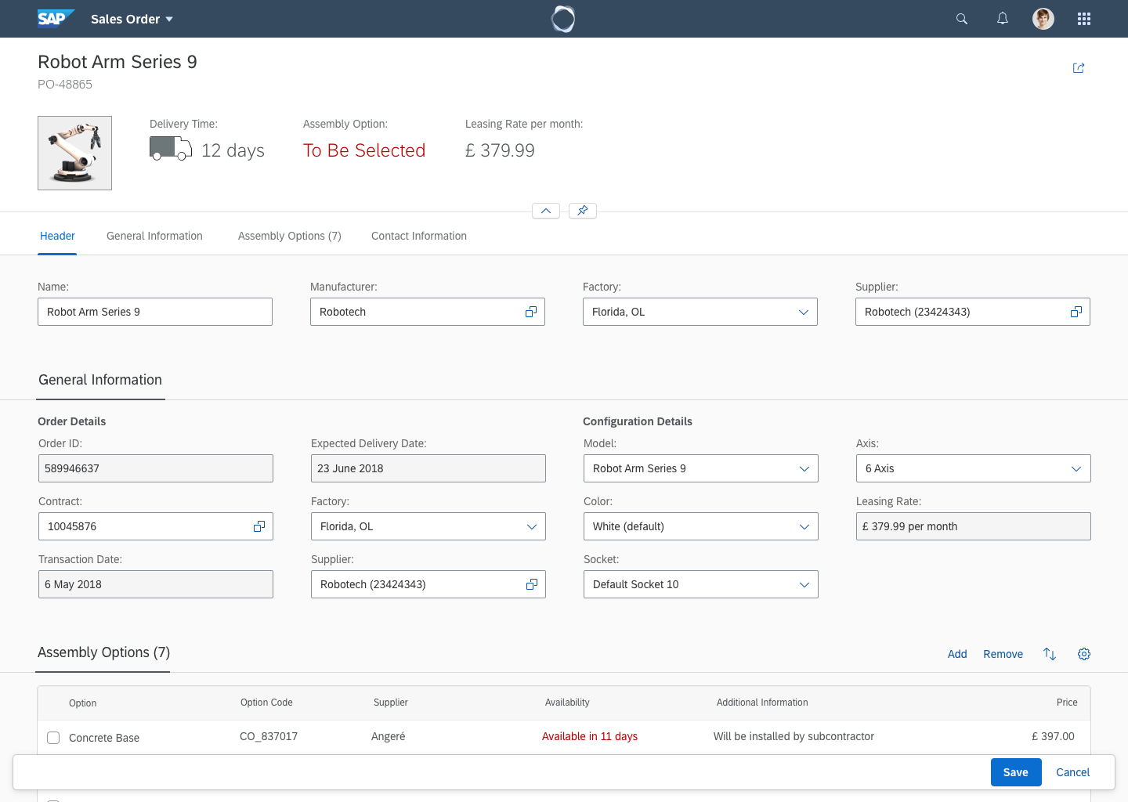
SAP Fiori elements provides standard UI logic out of the box
Filtering
Actions
Variant Management
Sorting
Personalization
Navigation
Search
Data Lists
Object Details
Editing (incl. draft mgmt.)

Slide 7
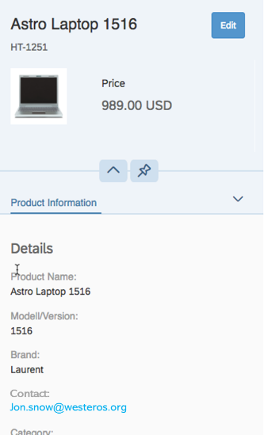
OData annotations describe attributes and relationships
“This entity can be edited”
For example:
The semantic of a field “This is an email address”
How fields are related to each other “This is the currency for this amount”
How information should be displayed “These fields shall be displayed together in a form”
The possible interactions with the business object “This entity can be edited”
“This is the currency for the amount”
“These fields shall be displayed together in a form”
“This is an email address”

Slide 8
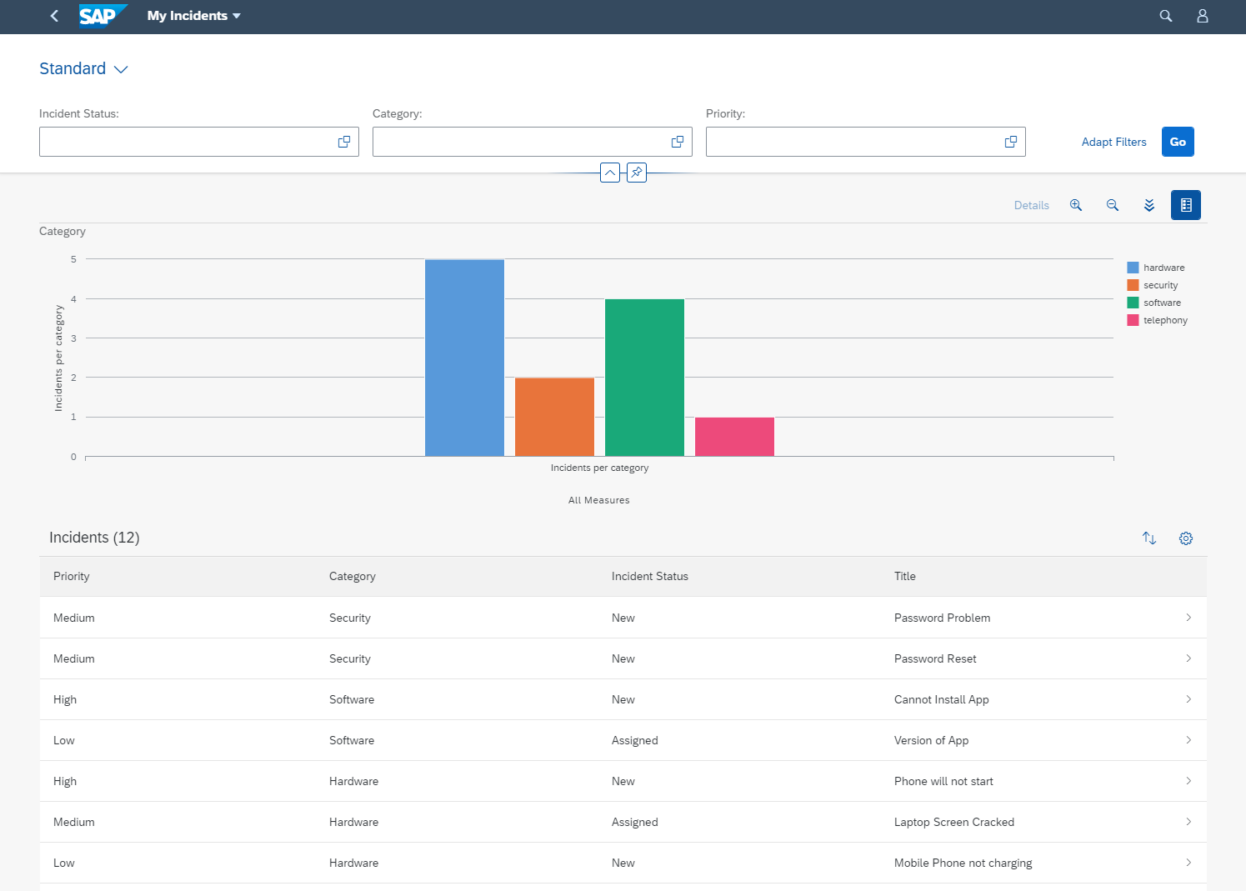
List Report UI Elements
SAP Labs Preview
Filter Bar
Chart*
Table
*Optional element

Slide 9
Table Definition
SAP Labs Preview
LineItem: [
{Value : priority_code},
{Value : category_code},
{Value : incidentStatus_code},
{Value : title}
]
Columns
UI.DataField
Table
UI.LineItem

Slide 10
Filter Bar Definition
SAP Labs Preview
Filter Bar
Filter Fields
UI.SelectionFields
Properties
SelectionFields: [
incidentStatus_code,
category_code,
priority_code
]

Slide 11
Chart Definition
SAP Labs Preview
Chart*
Dimensions
UI.Chart
Type
Chart : {
ChartType : #Column,
Dimensions: [category_code],
DimensionAttributes : [{
Dimension : category_code,
Role : #Series
}],
Measures:[IncidentsPerCategory],
MeasureAttributes: [{
Measure : IncidentsPerCategory,
Role : #Axis1
}]
Measures
*Optional element

Slide 12
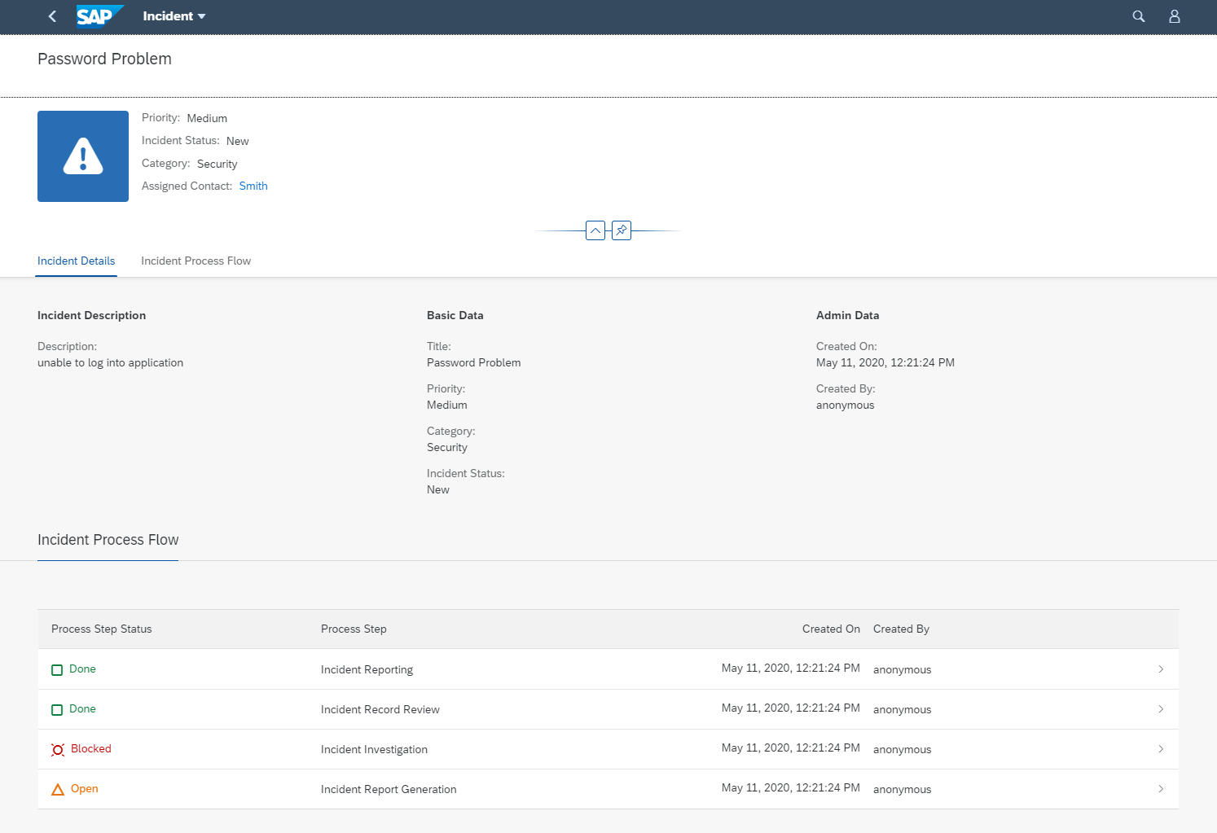
Object Page
SAP Labs Preview
Page Header
UI.HeaderInfo
Field Group
UI.FieldGroup
Sections
UI.Facets
Table
UI.LineItem

Slide 13
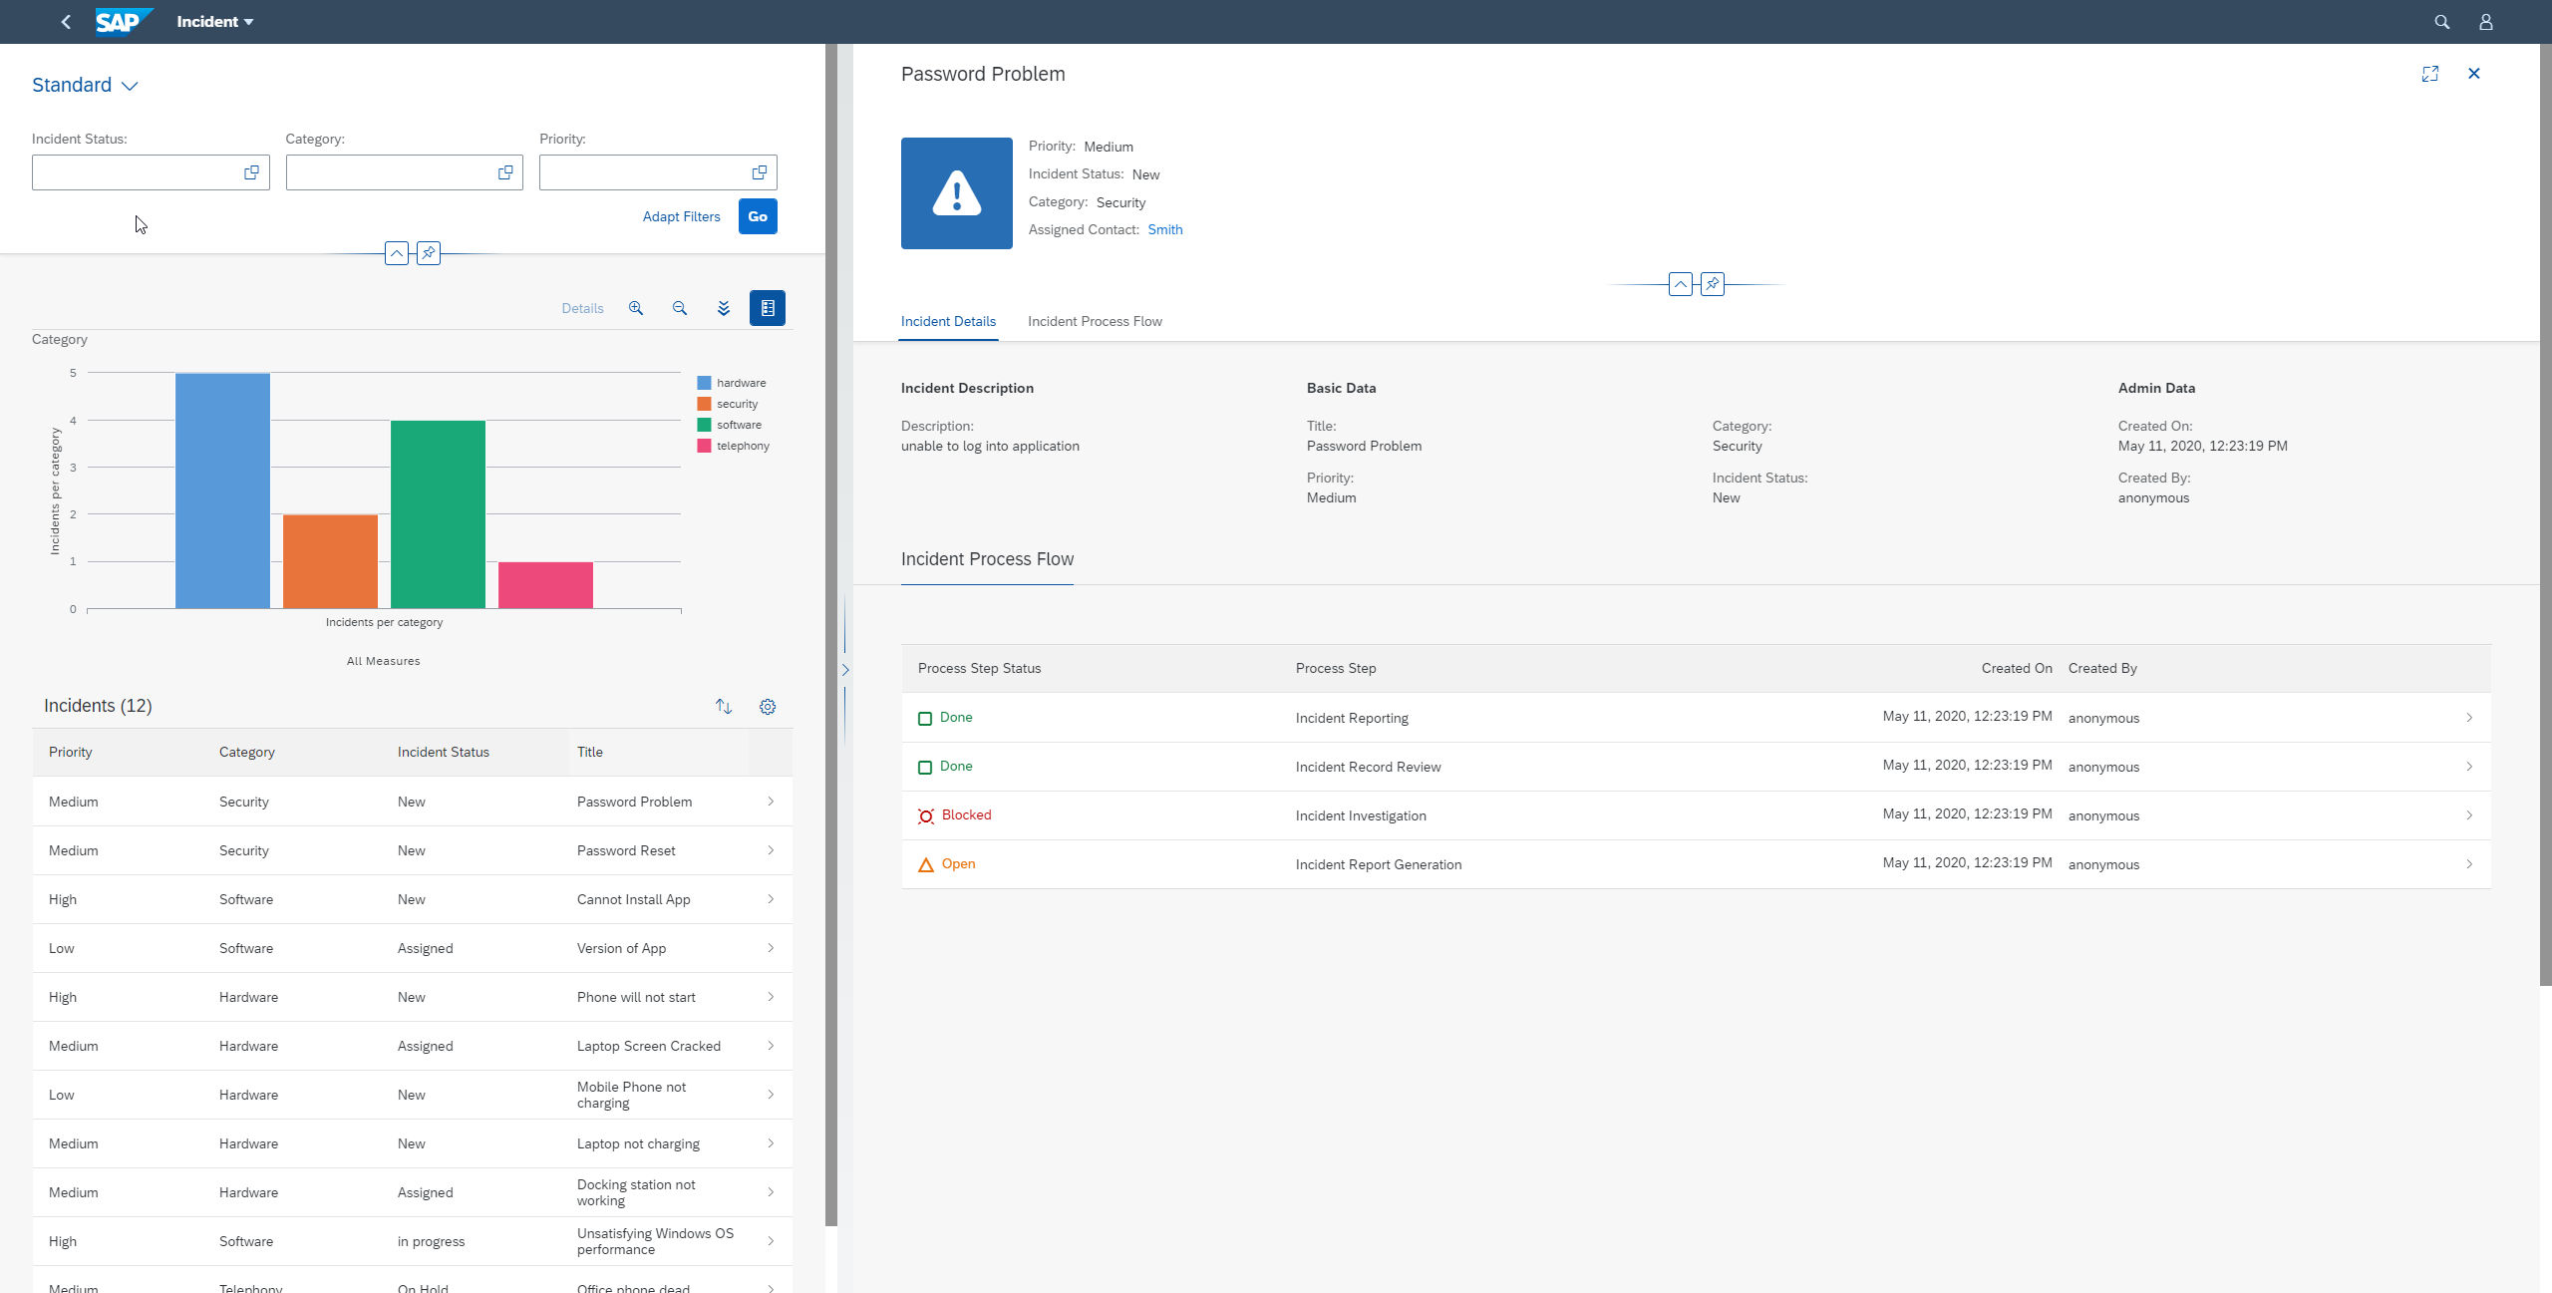
Flexible Column Layout
SAP Labs Preview
List Report
Object Page

Slide 14
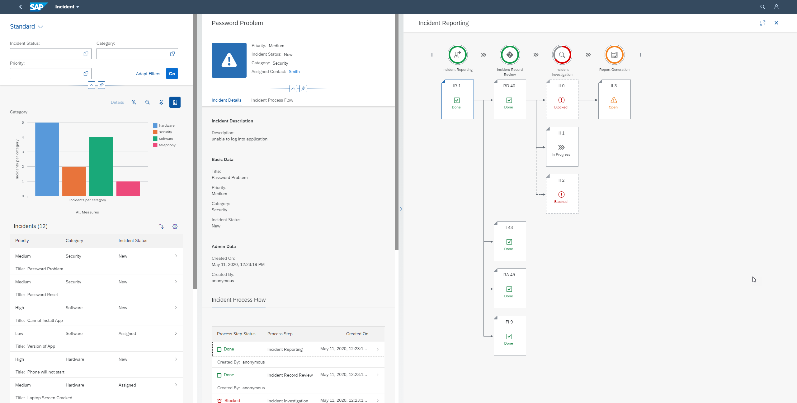
Flexible Programing Model
SAP Labs Preview
Custom Page

Slide 15
Options for rapid SAP Fiori app development
SAP Labs Preview
Visual Studio Code
Provides development flexibility with offline capabilities
Features a highly configurable development environment
Allows access to thousands of extensions from the Microsoft marketplace
Is part of a fast growing and vibrant open source community
SAP Business Application Studio
Allows easy access through a hosted environment
Provides a maintenance-free preconfigured environment
Integrates with existing SAP solutions and systems
Is guided by SAP product standard governance

Slide 16



3 things to remember about SAP Fiori elements and SAP Fiori tools
1. SAP Fiori elements and tools accelerates app development
2. SAP Fiori elements enables UX consistency
3. SAP Fiori elements covers 80% of app development scenarios

Slide 17

Thank you.
Roadmap
We plan to
conduct a Guided Beta program for SAP Fiori elements floorplans for OData v4 starting Q3/2020
be global available in Q4/2020
https://blogs.sap.com/2020/03/17/fiori-elements-floorplans-for-odata-v4-coming-soon/
Mariana Naboka
Product Owner
mariana.naboka@sap.com
Marcel Wächter
Development Architect
marcel.waechter@sap.com

